Slide 1
Vector Database

Slide 2
Agenda
Evolution of Databases
What is Vector Database
Vector Database Workflow
Pinecone Vector Database
Pinecone Demo
Matching Engine Vector Database
Matching Engine Index Building/Querying Process
Matching Engine Demo

Slide 3
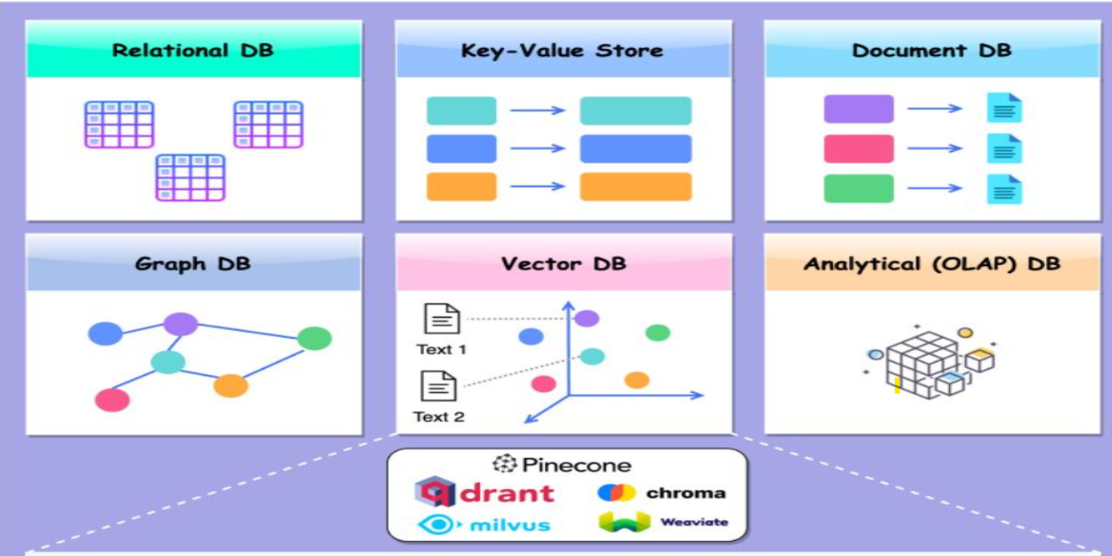
Evolution of Databases

Slide 4
What is Vector Database
A vector database is a type of database that stores data as high-dimensional vectors, which are mathematical representations of features or attributes.
Each vector has a certain number of dimensions, which can range from tens to thousands, depending on the complexity and granularity of the data.
The vectors are usually generated by applying some kind of transformation or embedding function to the raw data, such as text, images, audio, video, and others. The embedding function can be based on various methods, such as machine learning models, word embeddings, feature extraction algorithms.
The main advantage of a vector database is that it allows for fast(very low latency) and accurate similarity search and retrieval of data based on their vector distance or similarity (i.e. semantic or contextual meaning).

Slide 5
Vector Database Workflow
Train a ML model or use open source ML Model like TF or Hugging Face
Compute Embeddings(vectors) of the items using trained ML model.
Insert vectors into Vector DB
Query the vector DB to get the nearest match
Notes:
Train a ML model to learn embedding space where similar items are closer and dissimilar ones are far apart.
Compute Embeddings(vectors) of the items using trained ML model.
Embeddings represents the semantic information of the item,generated by AI model, and have a large number of attributes or features, making their representation challenging to manage.
Populate the embedding space (Vector DB) with the embeddings
Query the vector DB to get the nearest match

Slide 6
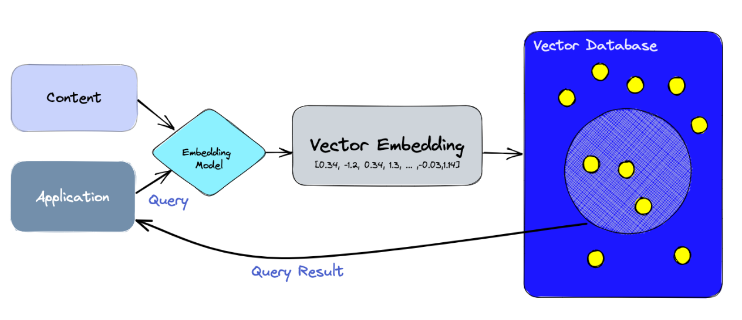
Vector Database Workflow

Slide 7
Pinecone Demo

Slide 8
Matching Engine
Vertex AI Matching Engine is Google offering for Vector DB that provides low latency and high scalability.
Also referred as Approximate Nearest Neighbor (ANN) or Vector similarity matching service
Matching Engine provides tooling to build real world use cases that match semantically similar/related items like Recommendation Engine, Search Engine, Text Classification, Image Classification etc.
How it works
Use pre-built or custom Deep Learning Model (like TF) to create embeddings (Vectors) from source/training data.
Store the embeddings (json/csv) in GCS Bucket
Create Index from the embeddings.
Create Endpoint and deploy the index to Endpoint for serving the queries
Querying/Serving :Use same model to create embedding of the query and submit query to get nearest matches

Slide 9
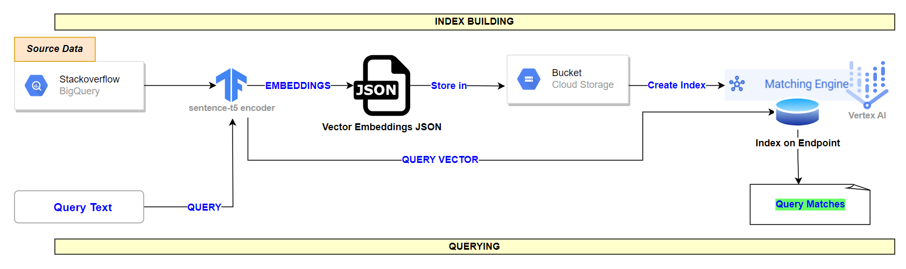
Matching Engine Index Building/Querying Process

Slide 10
Matching Engine Demo

Slide 11
Appendix

Slide 12
How Vector Database works
Train a ML model to learn embedding space where similar items are closer and dissimilar ones are far apart.
Compute Embeddings(vectors) of the items using trained ML model.
Embeddings represents the semantic information of the item,generated by AI model, and have a large number of attributes or features, making their representation challenging to manage.
Populate the embedding space (Vector DB) with the embeddings
Query the vector DB to get the nearest match
Notes:
Train a ML model to learn embedding space where similar items are closer and dissimilar ones are far apart.
Compute Embeddings(vectors) of the items using trained ML model.
Embeddings represents the semantic information of the item,generated by AI model, and have a large number of attributes or features, making their representation challenging to manage.
Populate the embedding space (Vector DB) with the embeddings
Query the vector DB to get the nearest match

Slide 13

Pinecone is a managed, high performing cloud native Vector Database with simple APIs to get query results with low latency at the scale of billions of vectors.
Pinecone offer optimized storage and querying capabilities for embeddings.
Vectors (Embeddings) records are stored in Pinecone indexes.An index is the highest-level organizational unit of vector data in Pinecone.
Each record in a Pinecone index contains a unique ID and an array of floats representing a dense vector embedding.
Each index runs on at least one pod.
Pods are pre-configured units of hardware for running a Pinecone service.More pods mean more storage capacity, lower latency, and higher throughput.
There are different types of pod : s1 pod, p1 pod, p2 pod

Slide 14
Pinecone
Pinecone supports vectors with sparse and dense values, which allows you to perform semantic and keyword search over your data in one query and combine the results for more relevant results.
Dense vectors support semantic search whereas Sparse vectors support keyword search.
In Pinecone, the resource hierarchy is defined as follows:
Organization (for billing)
Projects
Pinecone Indexes (Multitenancy)
Pinecone provides lots of APIs to manage the Indexes. Some of the Vector DB management APIs are
Create/Update/Delete Index
Data Operations : Insert /Update/Delete Vectors, Batch Upserts, Insert/Update Vectors with Metadata, Query Data
Partitioning index into namespace
Backup Indexes
Pinecone can be integrated with OpenAI, Elastic, Hugging Face, Langchain, Databricks

Slide 15
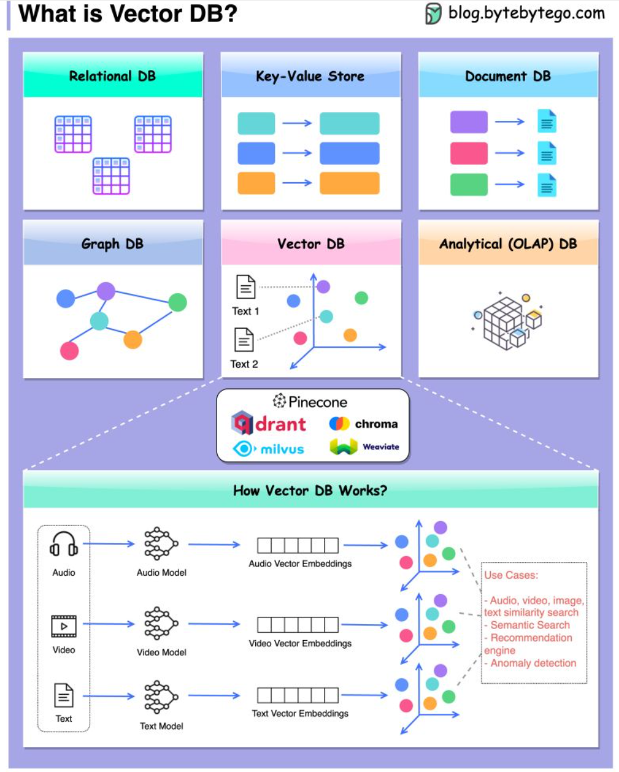

Slide 18
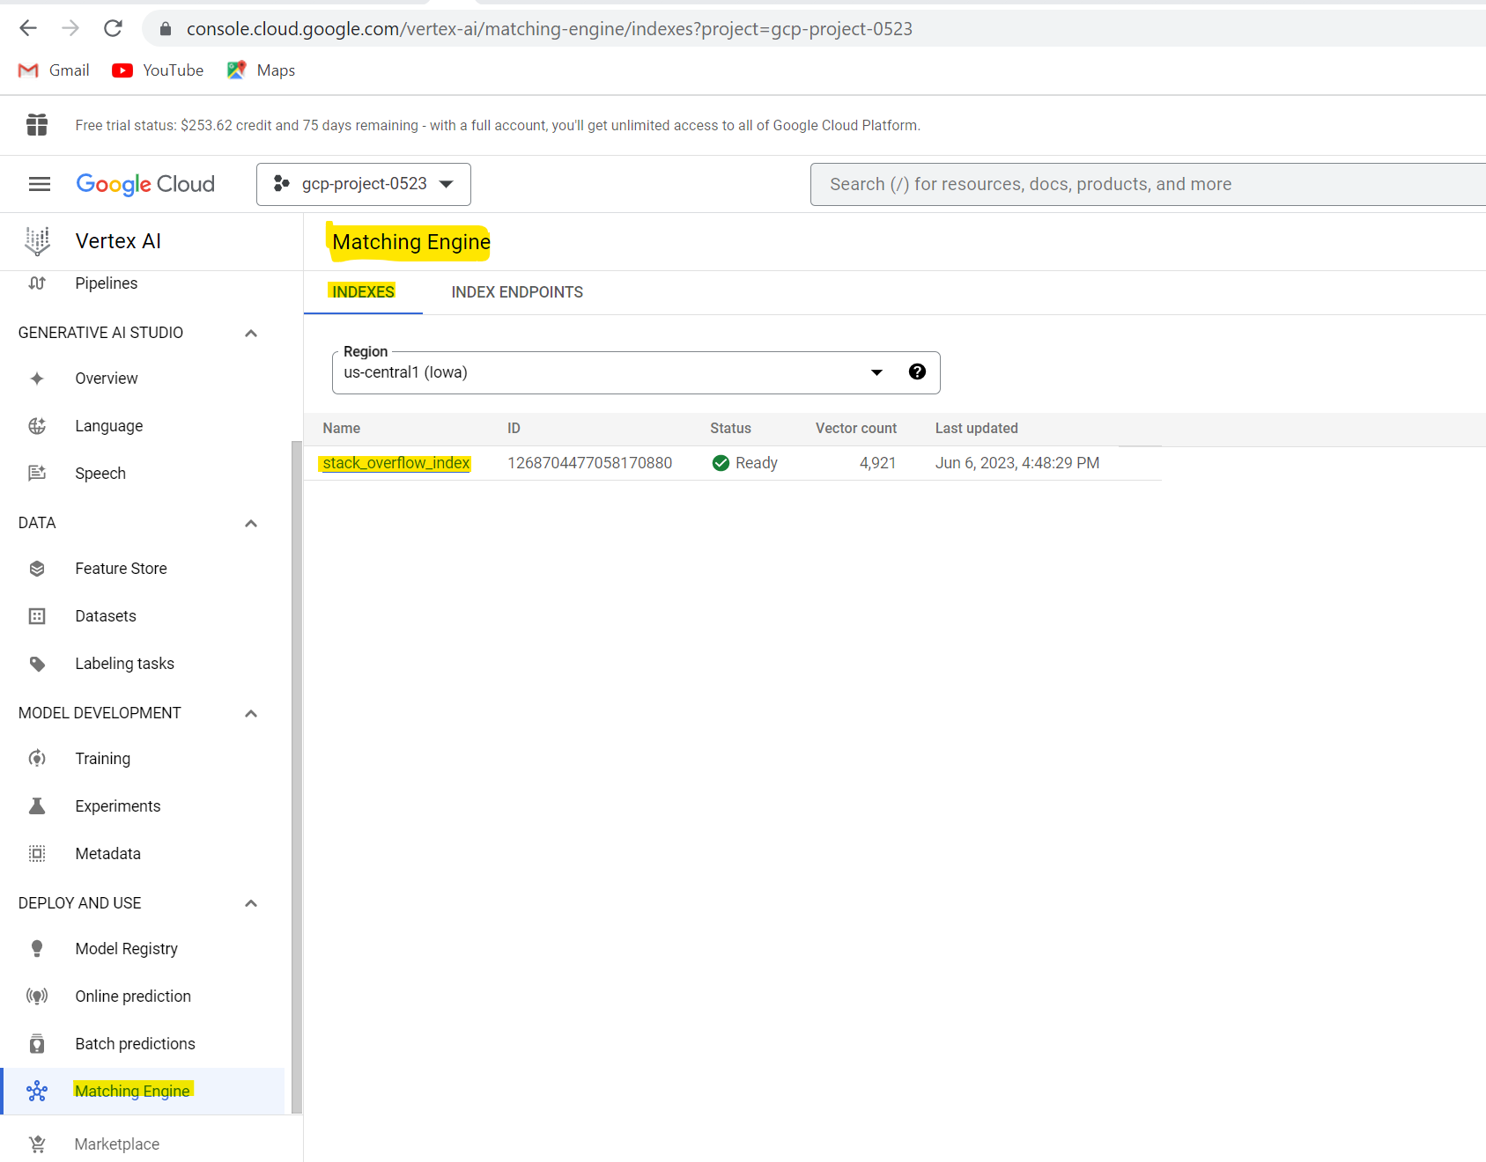

Slide 19
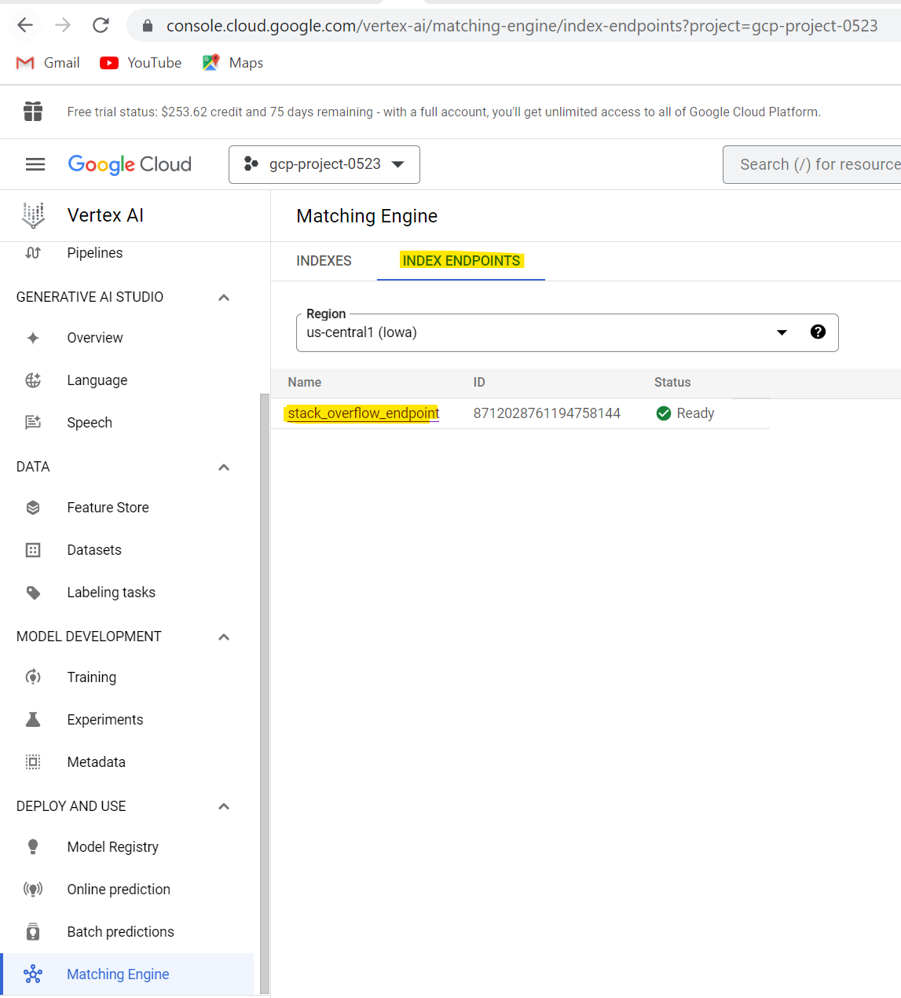

Slide 20
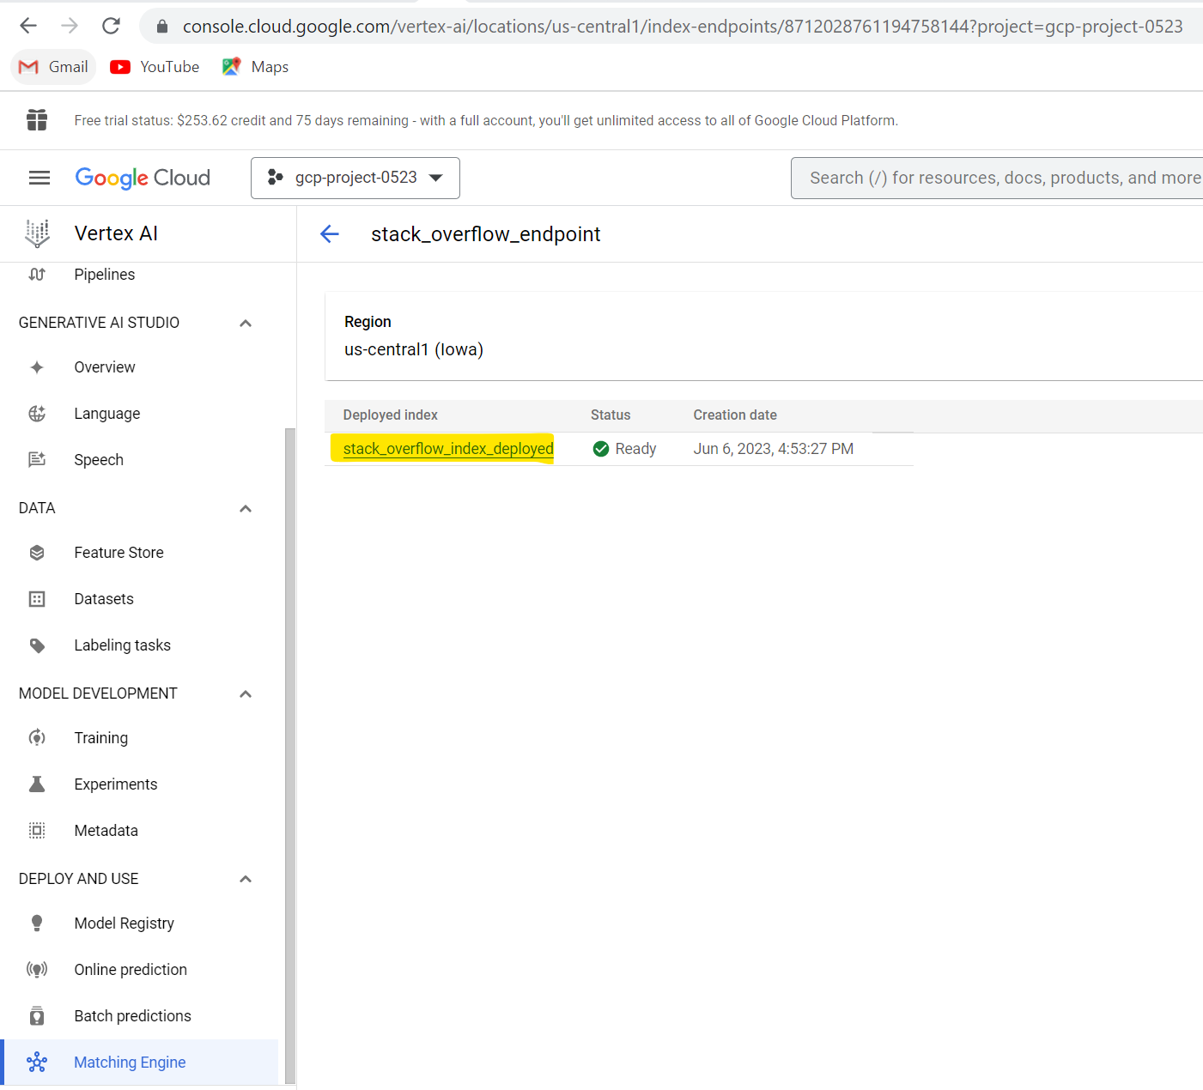

Slide 21
